Slide 1

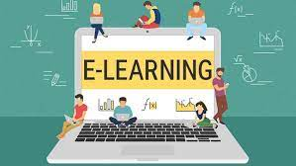
E-education (E-learning)

Slide 2


Slide 3
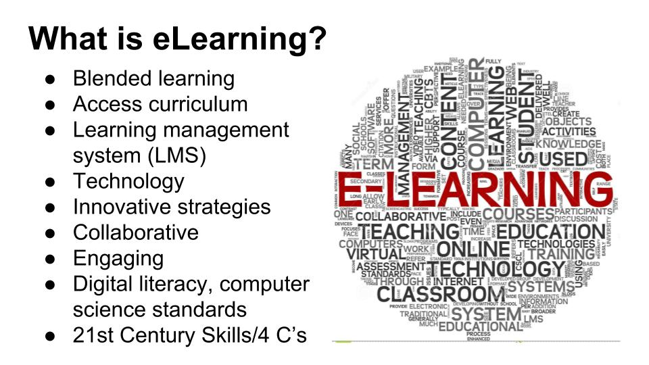

Slide 4
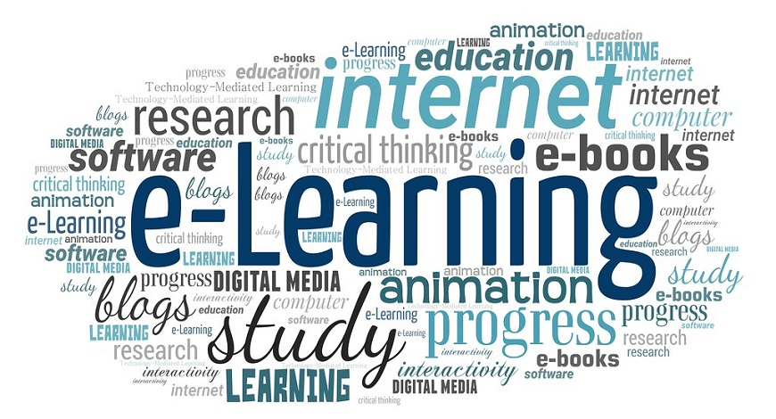
What is E-learning?
A learning system based on formalized teaching but with the help of electronic resources is known as E-learning. While teaching can be based in or out of the classrooms, the use of computers and the Internet forms the major component of E-learning.

Slide 5
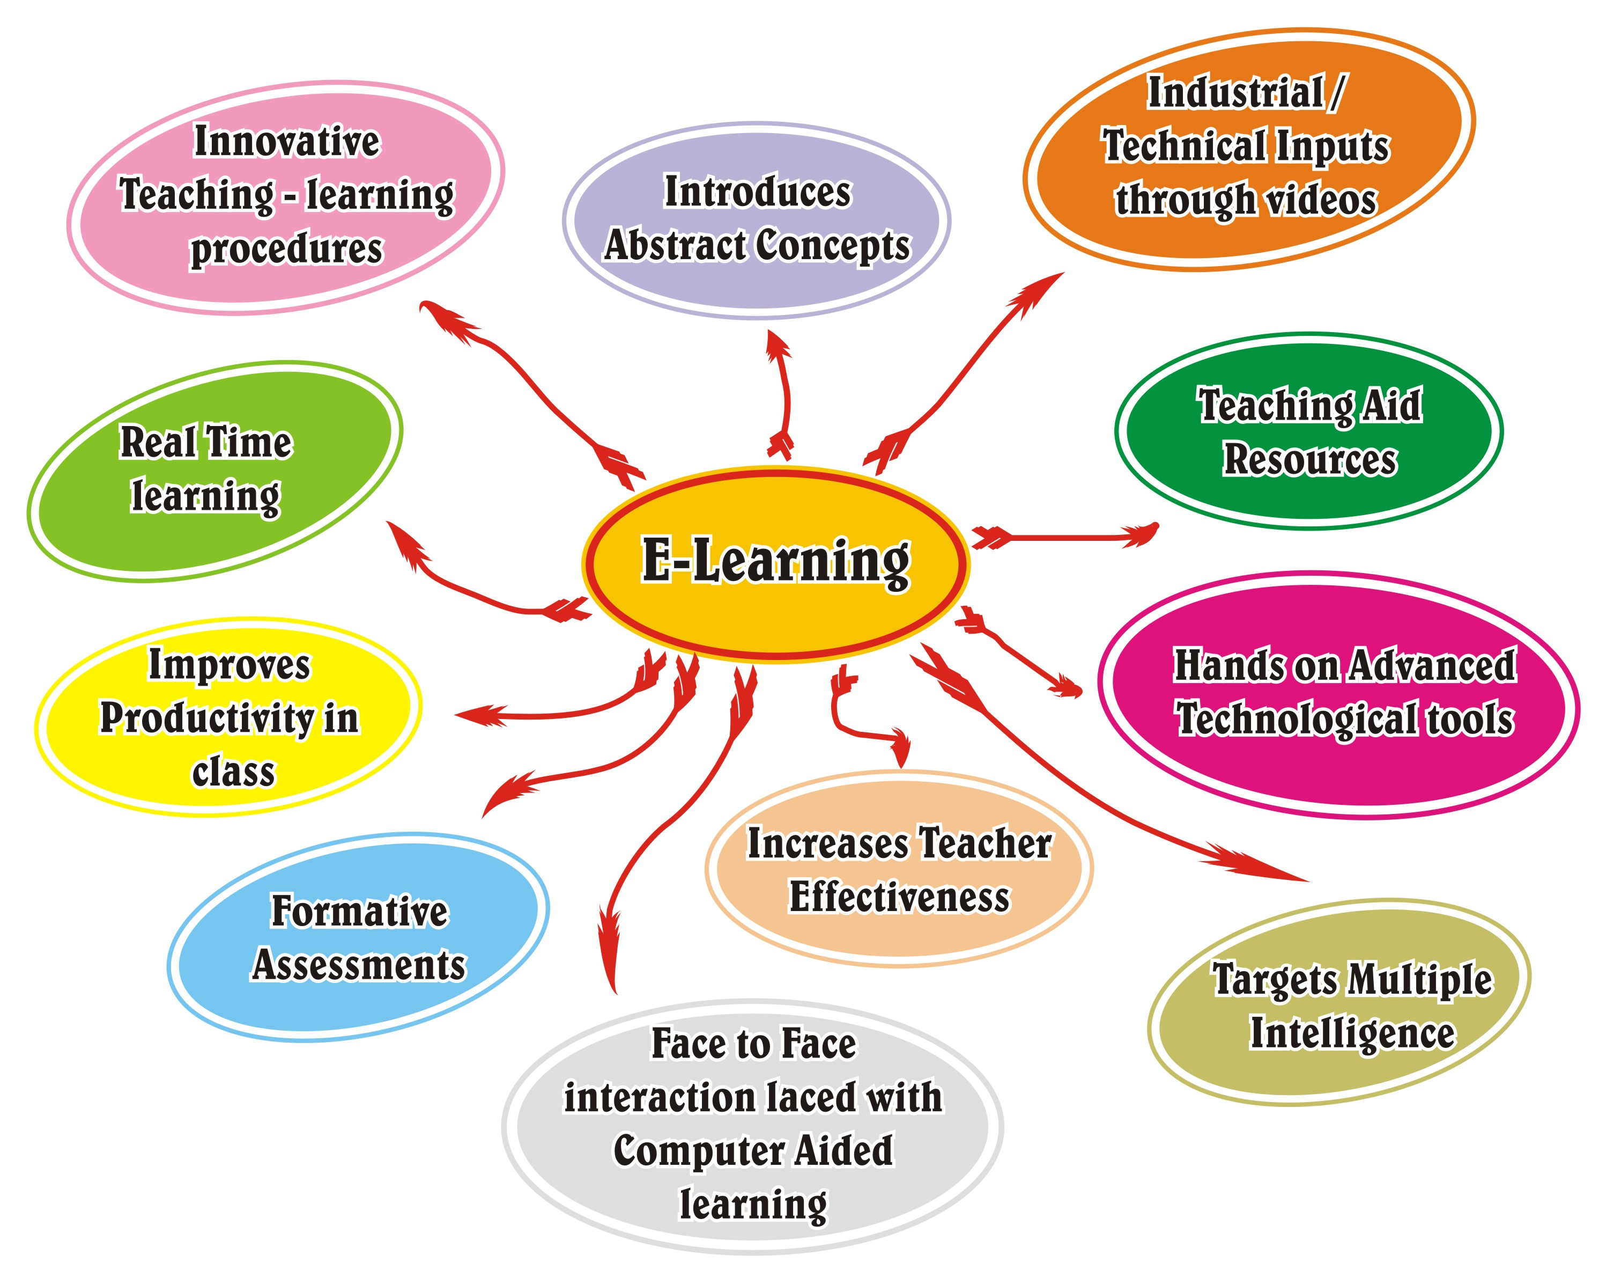

Slide 6

The Most Important Benefits Of e-Learning For Students.
Today's learners want relevant, mobile, self-paced, and personalized content. This need is fulfilled with the online mode of learning; here, students can learn at their own comfort and requirement. Let's have an analytical look at the advantages of online learning.

Slide 7
1. Online Learning Accommodates Everyone’s Needs
The online method of learning is best suited for everyone. This digital revolution has led to remarkable changes in how the content is accessed, consumed, discussed, and shared. Online educational courses can be taken up by office goers and housewives too, at the time that suits them. Depending on their availability and comfort, many people choose to learn at weekends or evenings.

Slide 8
2. Lectures Can Be Taken Any Number Of Times
Unlike classroom teaching, with online learning you can access the content an unlimited number of times. This is especially required at the time of revision when preparing for an exam. In traditional form of learning, if you can not attend the lecture, then you have to prepare for that topic on your own; in eLearning, you can attend the lectures whenever you want with ease.

Slide 9
3. Offers Access To Updated Content
A prime benefit of learning online is that it makes sure that you are in synchronization with modern learners. This enables the learner to access updated content whenever they want it.

Slide 10
4. Quick Delivery Of Lessons
eLearning is a way to provide quick delivery of lessons. As compared to traditional classroom teaching method, this mode has relatively quick delivery cycles. This indicates that the time required to learn is reduced to 25%-60% of what is required in traditional learning. There are some of the reasons why the learning time is reduced by eLearning:
Lessons starts quickly and also wrapped up in a single learning session. This enables training programs to easily roll out within a few weeks, or sometime even days.
Learners can define their own speed of learning instead of following the speed of the whole group.
Saves time as a student does not need to travel to the training venue. You can learn at the comfort of your own place.
Students can choose to study specific and relevant areas of the learning material without focusing on each and every area. For example, they can skip certain areas they do not want to learn.

Slide 11
5.Scalability
eLearning helps in creating and communicating new training, policies, concepts, and ideas. Whether it is for formal education or entertainment, eLearning is very quick way of learning!

Slide 12
6. Consistency
eLearning enables educators to get a higher degree of coverage to communicate the message in a consistent way for their target audience. This ensures that all learners receive the same type of training with this learning mode.

Slide 13
7. Reduced Costs
eLearning is cost effective as compared to traditional forms of learning. The reason for this price reduction is because learning through this mode happens quickly and easily. A lot of training time is reduced with respect to trainers, travel, course materials, and accommodation.
This cost effectiveness also helps in enhancing the profitability of an organization. Also, when you are studying at your own place, you are relieved from paying for travel expenses (e.g. accommodation) when training happens in another city/state and/or external learning materials.

Slide 14


Slide 15
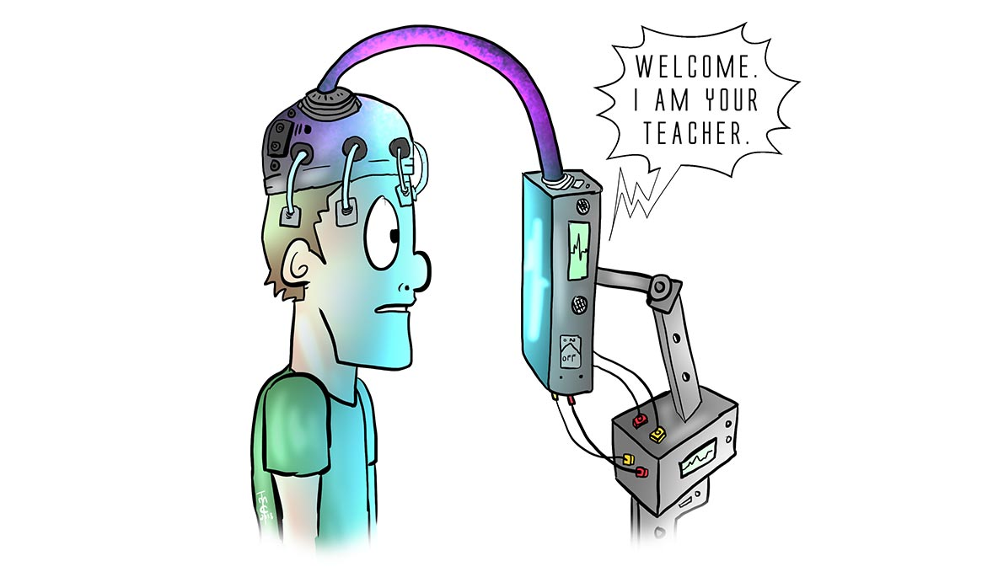
1. Lacks social interaction
E-learning is one of the causes of social isolation because you don’t see your teachers and classmates face-to-face anymore. Interaction is very limited to none.

Slide 16

2. Inaccessible to others
Consider yourself lucky if you’re located in an area where the internet connection is fast and stable. Unfortunately, some have very limited access to the internet. They have to go to internet cafes or use public Wi-Fis which is very inconvenient.

Slide 17
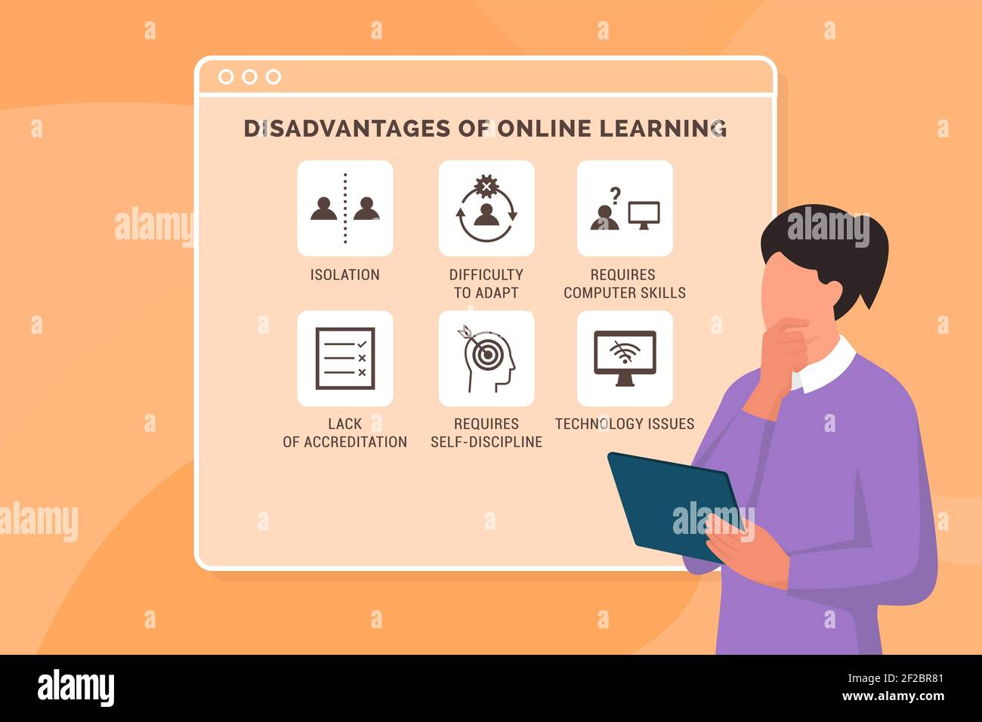
3. Cheating is unavoidable
E-learning includes assessment, just like in a regular classroom setting. However, there are no teachers or proctors to watch over you during exams. It’s easy for online students to share answers knowing there’s nobody watching.

Slide 18
4. Requires self-motivation and proper time management skills
You’re basically on your own in e-learning. You have to motivate yourself to study hard, take down notes, and gather more information. You should also manage your time well by learning how to juggle studying while doing other things like household chores or earning money part-time.

Slide 19
5. Focuses more on theory
You’ll spend most of your time listening to podcasts, watching videos, and looking at slide presentations. There’s no hand-on experience like conducting experiments.
It’s the most modern way of learning that requires only a gadget and internet access. However, it’s not for everybody. Being aware of the advantages and disadvantages of e-learning can help you decide whether this is for you or not.

Slide 20

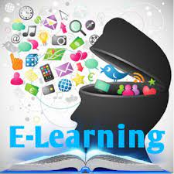
Various e-learning applications:-

Slide 21

byju’s
Byju's (stylised all caps) is an Indian multinational educational technology company, headquartered in Bangalore.It was founded in 2011 by Byju Raveendran and Divya Gokulnath. As of March 2022, Byju's is valued at US$22 billion and company claims to have over 115 million registered students.

